Slide 1

Graph Technologies for Healthcare
Dan McCreary
Distinguished Engineer
Advanced Technology Collaborative

Slide 2
Concrete Business Challenges
How do we migrate the 300M phone calls per year to advocates in a call centers to use chatbots to answer question?
How do we integrate reports of all recent member touchpoints to a advocate screen and create a recommended next-best action?
How do we develop of real-time clinical decision support (CDS) rules into point-of-care systems?
How can we do analysis of the UHC/Optum social graph to optimize staff placement, find innovators and increase collaboration?
How can we decommission expensive Netezza and similar hardware using lower-cost systems that are designed to handle complex queries
How do we integrate internet of things (IoT) and genomics data into the individual patient record?

Slide 3
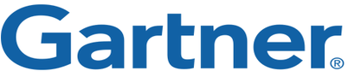
What are Graph Databases?
Graph databases is a method to store various datapoints – called vertices – along with their relationships – called edges. This results in computational efficiency when finding relationships between datapoints compared to traditional tabular databases
Graph analysis is possibly the single most effective competitive differentiator for organizations pursuing data-driven operations and decisions after the design of data capture.”
https://www.gartner.com/doc/2852717/it-market-clock-database-management

Slide 4
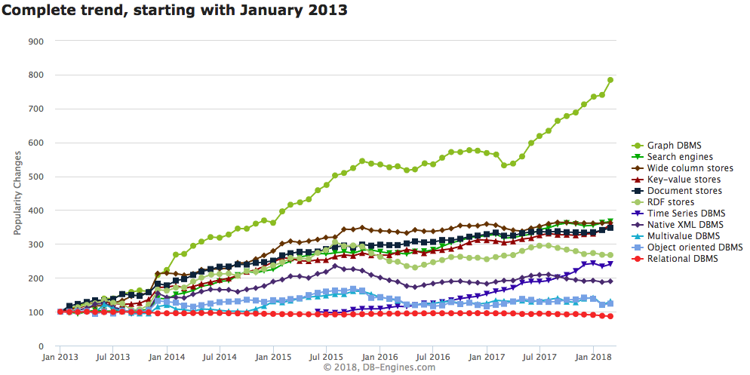
Graph Databases are HOT!
Graph Databases
https://db-engines.com/en/ranking_categories

Slide 5
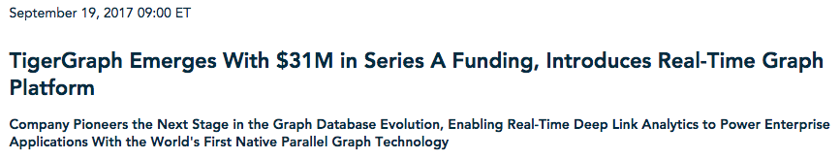
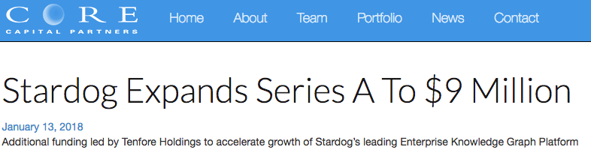
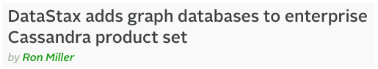
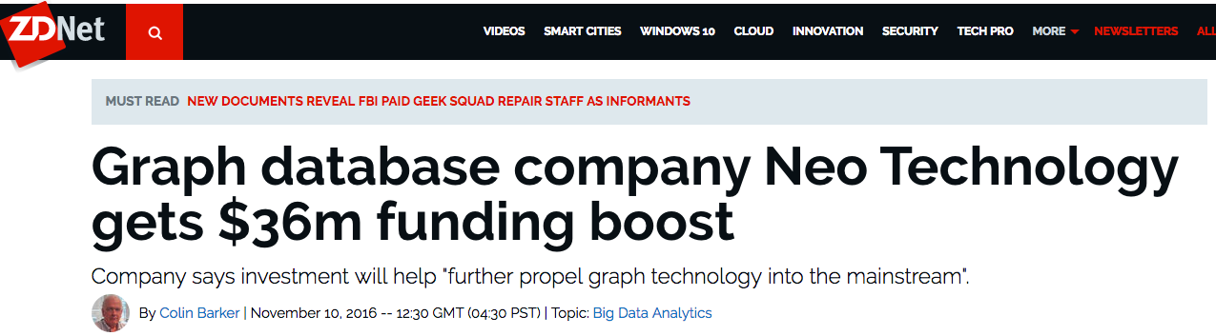
Venture Capital Pouring $$$$ into Graphs
Notes:
http://www.marketwired.com/press-release/tigergraph-emerges-with-31m-in-series-a-funding-introduces-real-time-graph-platform-2234189.htm
http://www.core-capital.com/stardog-expands-series-a-to-9-million/
https://techcrunch.com/2017/11/29/amazon-introduces-an-aws-graph-database-service-called-amazon-neptune/
https://techcrunch.com/2016/04/12/datastax-adds-graph-databases-to-enterprise-cassandra-product-set/
https://neo4j.com/news/neo4j-secures-36m-series-d-funding/

Slide 6
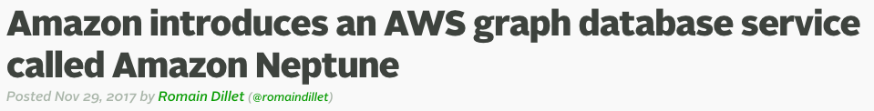
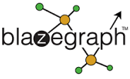
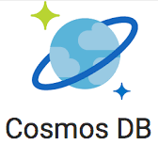


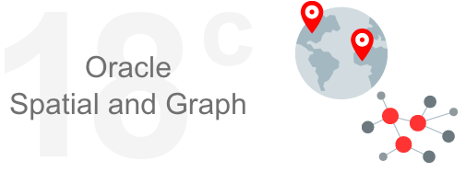
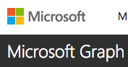

New Entrants into the Marketplace
RDF
Big players adding graph capabilities to existing systems
High Performance Computing (HPC) Graph Custom Hardware on FPGAs
Notes:
One of the big changes happened in November of 2017 when Amazon got into the graph business. Amazon now provide graph-as-a-service through their cloud-based Neptune graph database.
Companies like Microsoft, Oracle, IBM and DataStax also have efforts to enrich their products with graph offerings. General purpose analytical frameworks like Apache Spark are also adding graph analytics to their tools. Companies like MarkLogic and Cray Research have also enhanced their product lines with graph-related features.
Graph is no lingered considered a niche database. It is a mainstream database.

Slide 7











Which of the following organizations use graph databases?
Answer: They all do!
Every major airline uses a graph database to calculate fares in real-time
Over half of retailers use graphs for product recommendations

Slide 8
Six database architectures
Relational
Analytical (OLAP)
Key-Value
key
value
key
value
key
value
key
value
Column-Family
Graph
Document
See Chapter 1: https://www.manning.com/books/making-sense-of-nosql
8
Notes:
There are six main database architecture patterns. Graph is just one of these six – but closely related to documents.

Slide 9
Relational vs. Graph
Relational (row store)
Graph
ID
NAME
DATE
AMOUNT
Atomic unit of storage is a row of a table
Relationships are a secondary concern
Fast rows-by-row access but slow relationships traversal
Fixed data model
Atomic unit of storage are nodes and edges
Relationships are a primary concern
Relationship traversal is fast
1M traversed edges per second per core
Flexible data model
Notes:
Lets talking a bit about what a graph database is, and why they have advantages over some of the more familiar relational databases.
When we talk about relation databases, we’re talking about storing information in a tabular form. Technically, this is called a row store because they are highly optimized for storing uniform rows of data. By uniform we mean that every row has the same set of properties with the same datatypes for each of these properties.
If we want to connect that information to another type, such as, office locations, we have to a) hope that connection pathway exists, and b) use JOINs to link them together. As we start to ask more complex questions from our data, and in turn, require more joins, it can become expensive, slow, and operationally complex.
Graphs, on the other hand, take a radically different approach. Instead of rows and columns and tables, information is represented simply as “things” and “relationships”. Things on the graph can, and should be, of a variety of types, e.g. Employee, Location, etc., and the relationships tell us how these things are connected to each other.
Not only do graphs allow us to model our information in a way that better resembles the natural world, but the ability to connect different kinds of information in a graph can be anywhere from 1000 to 1M times faster; drastically reducing the barrier to entry on our complex business questions.

Slide 10
Our Brains are Graphs
100B neurons
10K Connections per neuron (degree)

Slide 11

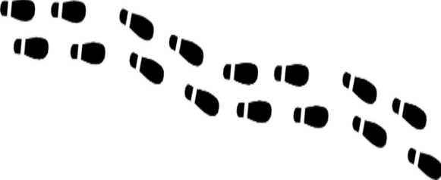
How do you get to your neighbor’s house?
You walk out your door, point to house, walk directly to the house
Your houses are “Adjacent” so getting there is a direct “hop”
You don’t need to consult anyone else about how to get to a neighbor’s house because you have the right pointer
Relationships pointers are created at data load time, not at query time
Notes:
Sometimes the best way to understand how graph databases are different is using a metaphor. We call this metaphor the “Neighbor Walk” metaphor. It has proven very helpful for people that are trying to understand the performance differences between relational joins and a graph traversal.
Let’s say you want to walk out your front door and over to your neighbor’s house. You open the door, point you body to the neighbor’s house and walk over there. Pretty simple. Since your houses are adjacent this is the logical way to do it.

Slide 12
Logical Graph Model
LIVES_NEXT_TO
Dan
Ann
If two physical items are related, they have a relationships arc between them and we model it like the above
We build a “logical” data model that has this link
In a native graph, the vertexes are loaded into memory and then the physical memory addresses of each link is also reflected in each of the nodes
Notes:
Here is the graph “logical model” for this. You might have a vertex for your house, a relationships called LIVES_NEXT_TO as a pre-calculated relationship to your neighbor’s house.

Slide 13


Relational Database Use Indexes
Central
Index
Search: 123 Main St.
1,000x slower
You must walk to a central index system
The index system does a “search” given the house’s address
The index system will tell you how to get to your neighbors house
Notes:
Here are the steps that are reflective of how a relational databases does joins
Walk out the door
Walk downtown to the DMV where they have a service that tells you how to get to your neighbor’s house
When you get to the DMV you take a number
When your number comes up you get called by a search agent
You give your neighbors name to the DMV search agent
The search agent at the DMV has a list of all the people in your town sorted by their address (called the index). They search the list (using a binary search algorithm) and they finally give you the GPS coordinates of your neighbor’s house.
You take these GPS coordinates, enter them them into your GPS tracker and follow the directions to Ann’s house.
Now granted the metaphor is not perfect. The speedup really depends on how many rows each table has. However, this metaphore helps you remember that sometimes directly addressing a memory location that is pre-calculated for you at load time can sometimes be three orders of magnitude faster than searching for something every time you need to access it. RDBMS systems try to minimize this search time by doing clever things like caching. However the more data you have the longer the searches take. Direct memory access will always be faster than doing a search!
Now lets also look at some different architectures than a single node graph.

Slide 14
Relationship Traversal
Relational Joins
Graph Joins
Joins are pre-computed pointers. There is no search. Pointers are calculated at load. (index-free adjacency)
Each node and edge has the complete set of information it needs to access all neighbors with a single fast operation
As long as all pointers can be stored in RAM performance is very fast – typically 1 million hops per second per core
Performance is independent from data size as long as pointers stay in RAM
Joins are executed every time you query (traverse) the relationship
Executing a join means to search for a key in another table
Even with indices, executing a join usually means looking up a key in a B-Tree Index: O(log(n))
All join operations get slower as the data size increases
Notes:
Now lets take a careful look at the way we traverse relationships in both technologies. Relational databases need to do searches in real- time every time you do a join. Graph database pointers are computed when you load the data. Because the memory locations are pre-calculated, you are only putting new memory locations into the CPU to hop between relationships. These operations are usually very fast! Typically 1 million hops per second per core. If your sever has 16 cores that means you can analyze 16 million relationships each second.

Slide 15
Graphs and the “Open World” Assumption
Past: Closed Word
Graph: Open World
CLOSED!
Everything is prohibited until it is permitted
You can only add data that you model
Everything is permitted until it is prohibited
Anyone can easily add any data at any time without disruption of services
Notes:
http://www.mkbergman.com/852/the-open-world-assumption-elephant-in-the-room/

Slide 16
The Knowledge Triangle
Wisdom
The Knowledge Triangle or the “DIKW” pyramid
Diagram for representing the relationships between data, information, knowledge, and wisdom
Too often we focus on “Big Data” and not enough on connected knowledge and transferrable knowledge
Graphs are connected information concepts
Wisdom is reusable across multiple context
Can we capture knowledge in a form that can be reused across multiple domains?
Knowledge Patterns Relationships
Information - Concepts
Data - Binary, Codes, Data Lakes
https://en.wikipedia.org/wiki/DIKW_pyramid
Notes:
Now lets take a look into some of the reasons that organizations are moving toward knowledge graphs as ways to connect and reuse data. The structure we used to describe this system is called the Knowledge Triangle or sometimes the DIKW Pyramid. It is a triangle with Data at the bottom, Information at one level up, connected Knowledge (in the form of a graph) at the third level and Wisdom at the top.
In most systems, Data comes from external sources the form if low-level binary and numeric codes. For example this might be a table-by-table dump from a RDBMS system into a set of CSV files. However, the metadata that describes these codes is often not transmitted with the data. So it is difficult to figure out what the codes mean. At the Data level it is expensive and time consuming to find the meaning of data. We call this semantically poor data.
Some information might be stored at a higher level – we call this the Information level. At this level we clearly identify the nouns in the data. We find the people, places and things. But these things may not be connected together.
JSON and XML files are good choices to transmit information because they send labels with the data.
The next higher level is the Knowledge level. Knowledge is Information that is put in the right context – it is connected to other concepts. The Knowledge level allows us to focus on large patterns that stretch across multiple domains. We can move between Providers, Claims, Services and Members by doing queries over our graph.
The Wisdom is the layer most strongly associated with AI. When we think of going to the top of the mountain and we ask the Gurus for advice, we are asking them to apply their knowledge to our specific problem. We are asking them to transfer knowledge to our context.

Slide 17
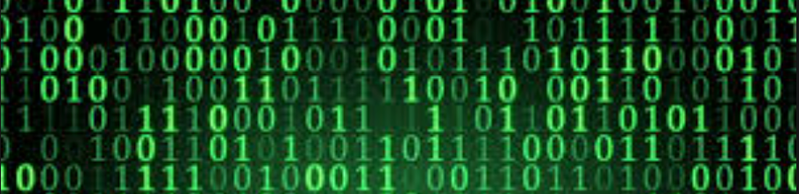
From Raw Data to Wisdom
Knowledge that can be reused across multiple context
Reusable To New Problems
Wisdom
Connections
De-duplicated
Knowledge
Graph
Continuous
Enrichment
Consistent
Filament
Tagged Text
Concepts
Validity
Information
Semantics
Defintions
Searchable
Raw data dumped from a database, log files or documents
Data Lake

Slide 18
When should we use a graph database?
Relationship Intensive Data
Dynamic-Variable Data
How do work with relationship-intensive data?
How do we traverse millions of relationships per second?
How do we easily connect new data sources into our graph?
How do we work with highly variable data?
Can we continually evolve and enrich our data?
Can we combine unstructured documents in our data?
How do we link metadata to our data? (versioning, provenance, veracity)
Looking for Patterns
Evaluate Complex Rules
How do we find complex patterns in our data?
Can we be notified of anomalies in data?
How can we visualize groupings of data?
How do we find similar items?
How do we quickly evaluate many complex rules?
How do we compare new data to existing data?
How can we lookup complex transformation rules?
How do we run many validation checks for data quality?
Notes:
Here is a list of 11 questions that you can use to help understand if your business problem might be a good fit for a graph database.

Slide 19

Three Eras of Computing
1) Procedural Era
Data
Programs
Answers
Procedural Code (Rules)
Explanations (Why)
2) Machine Learning Era
Data
Machine
Learning
Rules (10M weights)
Answers
3) Graph Era
Data
Knowledge
Answers
Machine
Learning
Explanations (Why)

Slide 20
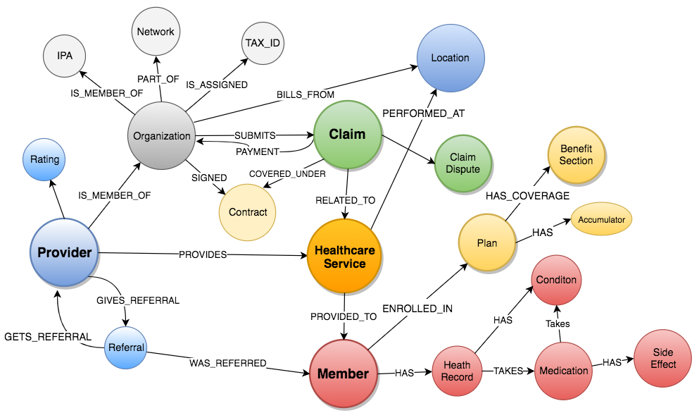
Healthcare System Graph
Notes:
Healthcare data is not like a general leger data. There are many complex relationships between our datasets. Especially when we start to look at clinical data. We think the best way to understand this data is to load it into a graph database.

Slide 21
“We just had a new baby. What are my benefits?”
Reusable, adjustable graphs (a.k.a. ontologies) are used to classify benefit documents and to accurately search benefit plans.
Infant
Baby
Child
Mental Health
Maternity Care
Physician Visits
Benefit Plan
Surgical Procedures
Preventive Care
Notes:
At the beginning of this class we talked about how Google and other search companies use knowledge graphs to help search. We also want to show how this same technology is being investigated to improve the search quality of Benefit Plan searching.
Our challenge is that our users use different words to search for answers. For example, they might ask “We are planning to have a new baby. What is covered by my plan?”. But the word “Baby” is not listed in the Maternity Care benefit section. So the search would return no results.
In an effort to overcome this obstacle, a solution that uses reusable, adjustable ontology models to classify benefit documents can be used. This leads to a smart search experience through the promotion of semantic search, allowing users to search using everyday language and receive the appropriate information.
Our ontologies allow us to harmonize disparate data sources and through the classification process we can extract facts and relationships in documents.

Slide 22
Benefit Plans are Graphs
Visualizer mode of Smartlogic Semaphore
Ontology Editor
Nodes each have a Class
(color)
Benefit Sections are Nodes
Nodes are connected by typed relationships (links)
Semantic searching of Benefit Plans involves understanding the “distance” between concepts. This is used for search and chatbot question answering systems.

Slide 23
Documents are Graphs
THIS SERVICES AGREEMENT (this "Agreement"), effective as of March 15, 2018 (the "Effective Date"), is entered into by and between Acme Services, Inc. ("Company") and United HealthCare Services, Inc., for the purpose of setting forth the terms and conditions under which Company will provide certain services to United HealthCare Services, Inc. and its Affiliates (collectively, "UHS"). As used herein, "Affiliate" means any entity directly or indirectly controlled by, controlling, or under common control with United HealthCare Services, Inc. Any Affiliate may receive Services (as defined below) under this Agreement.
type=date
Effective Date
March 15 2018
type=company
Contract
Service Provider
Acme Services Inc.
type=company
Service Consumer
United HealthCare
relationships
Facts can be extracted directly from text documents and placed into a graphs

Slide 24
Sample Graph Traversal Patterns
Dependencies
Failure chains
Order of operations
Clustering
Finding related items
Friends, fraud networks
Similarity
Similar paths and patterns
API
Server
Auth
Data
Matching/Categorizing
Look for and tag specific patterns
Flow/Cost
Optimize costs based on routing
Path optimization
Centrality/Search
Which nodes are the most connected or relevant?
Notes:
Dan

Slide 25
Top Graph Use Cases
Use Case | Description | Business Sponsor | Phase
M&R Member Journeys | Bring together all member interactions to identify simplification opportunities and empower advocates and influence NPS Scores | M&R - Sid Bothra | POC
Provider Fraud | Bring third party data sources into Health System Graph and empower PI team to identify fraud faster | Optum Payment Integrity | POC
Human Capital | Build profiles of knowledge workers and improve productivity | HC – Rich Hughes | POC
IHR Graph | Create IHR graph model, load de-identified IHR data and work on answering various utilization questions | CentriHealth – JP | POC
Health Care Platform Graph | Working with Keith Tanski’s team to use Graph DB to store relationships between capabilities and systems to power the Search capabilities they are envisioning | Tab Chowdhury | Research
Optum Rx | Connect all of the data sources needed by pharmacist to automate Rx Pre-authorization | Evan Andricopoulos | Research

Slide 26
Take Home Points
With graphs, we can solve some hard problems that we have never been able to solve before:
We can quickly integrate highly variable dynamic data
We can work with complex rules
We can do deeper analysis to find hidden patterns

Slide 27

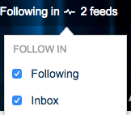
Graph Resources
Graph Databases on Hub
200+ members as of December 2018
Graph Presentations
Vendor analysis, blogs
Links to recorded tutorials
Links to other graph resources
https://hubconnect.uhg.com/groups/graph-databases
Graph Confluence Wiki
TigerGraph Quickstart Guide, Training
Hands-on graph engineering notes
Docker images and loader best practices
Deployment scripts
https://new-wiki.optum.com/display/ATC/Graph+Stores
Graph Training in LearnSource
Introduction to Graph Databases (342554)
Graph Ideas and Use Cases on Aha!
Use this to see the status of Graph projects within Optum and UHC
https://optum.aha.io/products/AIGD
Here is the use-case status report: https://optum.aha.io/bookmarks/idea_grids/6577002559035096046
Note: You must ”Join” and “Follow” to get e-mail updates from the graph team!
Notes:
If you would like to continue to learn more, we encourage you to join the Graph Technologies Hub site. Make sure to click the Follow button on the upper right corner of the screen.

